Slide 1

Knowledge Distillation (KD)
Team 열려라 참깨

Slide 2
INDEX
1. What is Knowledge Distillation?
2. Basic Knowledge Distillation
3. Knowledge Research
Feature-Based Knowledge
Relation-Based Knowledge
4. Distillation Research
Online Distillation
Self-Distillation
6. Distillation Algorithms
7. Applications

Slide 3
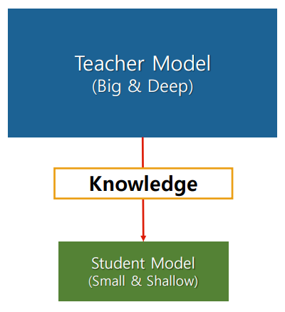
1. What is Knowledge Distillation?
Teacher model: Complex models with high predictive accuracy.
Student model: Simple model that receives the knowledge of the Teacher model.
Transfer knowledge of the teacher model.
have similar performance in the student model.

Slide 4
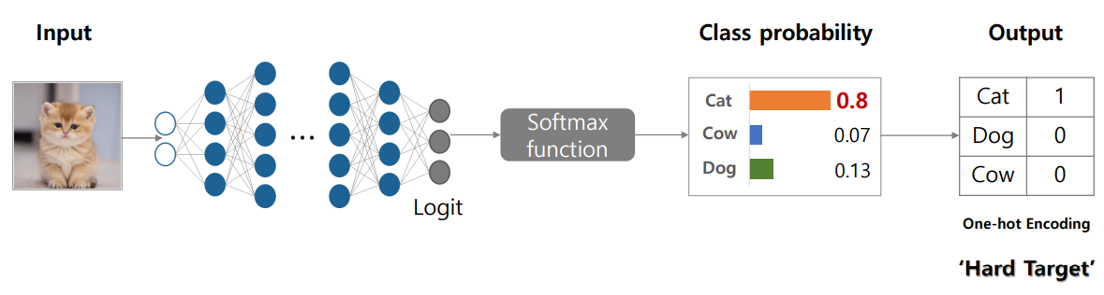

2. Basic Knowledge Distillation
Knowledge

Slide 5
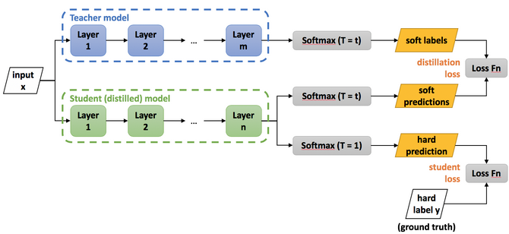
2. Basic Knowledge Distillation
Knowledge

Slide 6
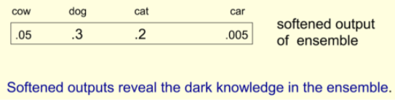



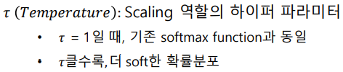
2. Basic Knowledge Distillation
Knowledge

Slide 7
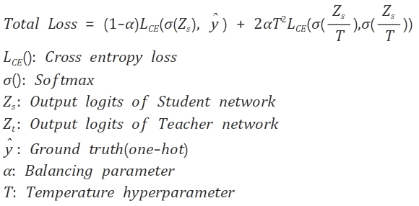
2. Basic Knowledge Distillation
Distillation
L_{student}
L_{distillation}

Slide 8
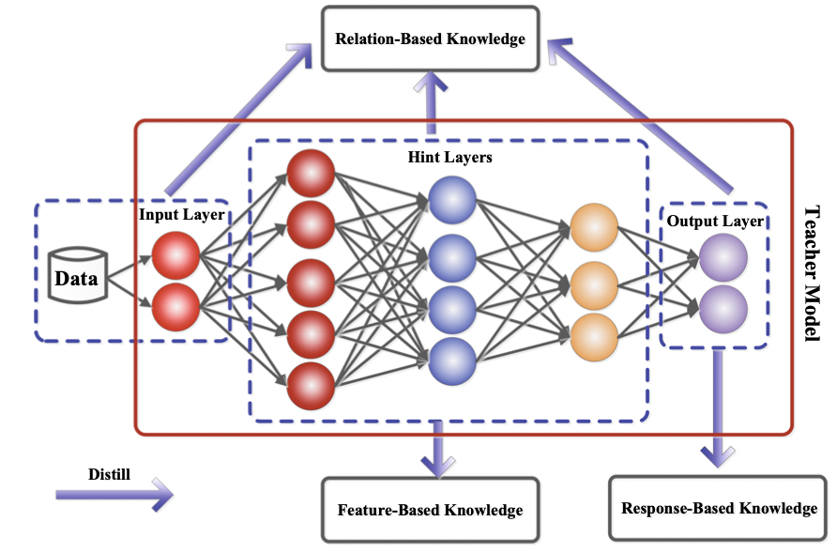
3. Knowledge Research

Slide 9
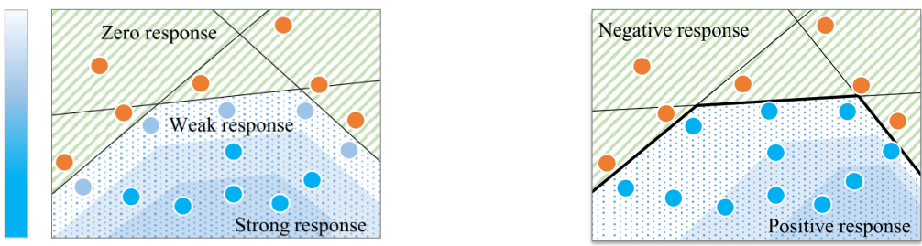
3. Knowledge Research
Feature-Based Knowledge
traditional method
Suggestion method
Magnitude

Slide 10
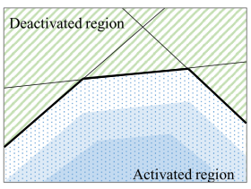
3. Knowledge Research
Feature-Based Knowledge
good decision boundary
good generalization performance
Decision boundary
Consists of a combination of each hidden layer boundary.

Slide 11

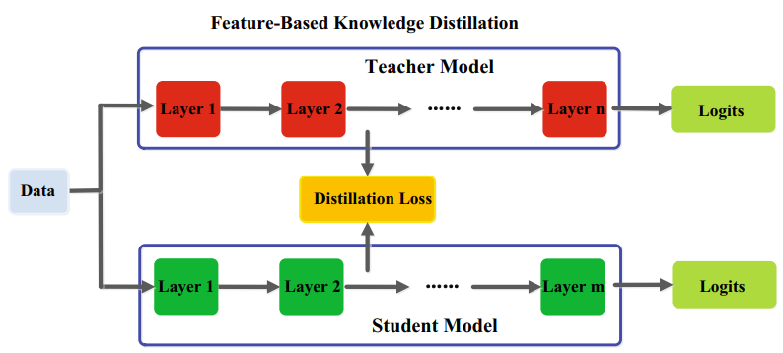


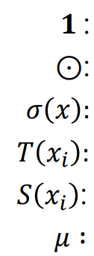
3. Knowledge Research
Feature-Based Knowledge
to differentiate
one vector
element-wise multiple
ReLU
Response vector of hidden layer of Teacher model
Response vector of hidden layer of Student model
Decision Boundary margin

Slide 12
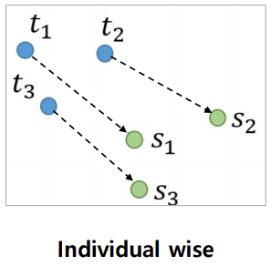
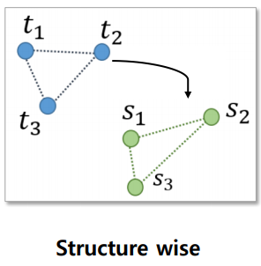
3. Knowledge Research
Relation-Based Knowledge
Traditional method
Suggestion method

Slide 13
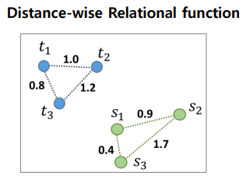
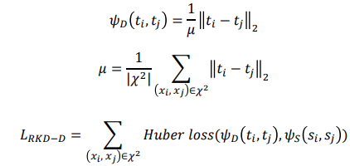

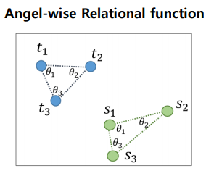
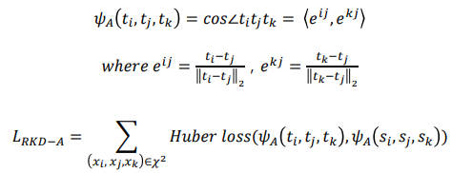
3. Knowledge Research
Relation-Based Knowledge
: Relational function

Slide 14
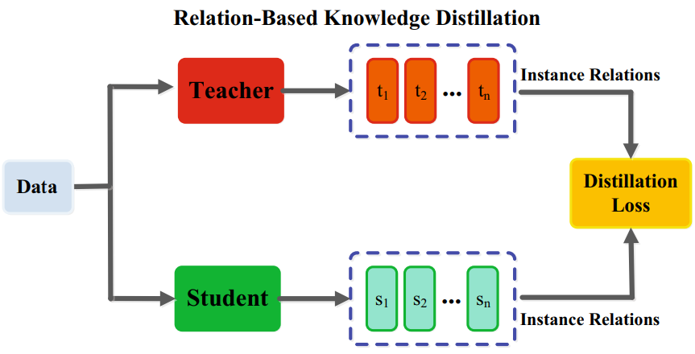

3. Knowledge Research
Relation-Based Knowledge
Huber loss
It can be mapped by itself.

Slide 15
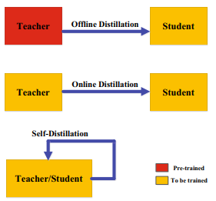
4. Distillation Research

Slide 16
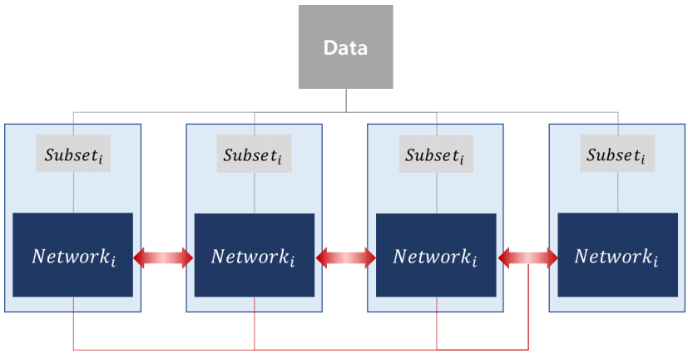
4. Distillation Research
Online Distillation
In addition to data parallel processing through multi-GPU, the copied networks transfer knowledge to each other.
Improve accuracy
and learn faster.

Slide 17
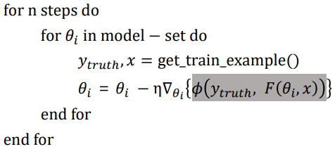
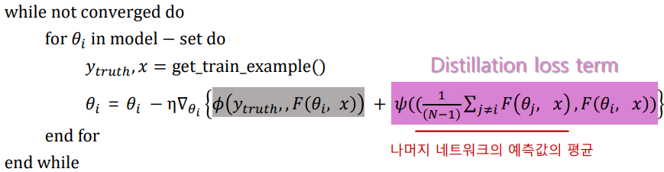
4. Distillation Research
Online Distillation
proceed in parallel.

Slide 18
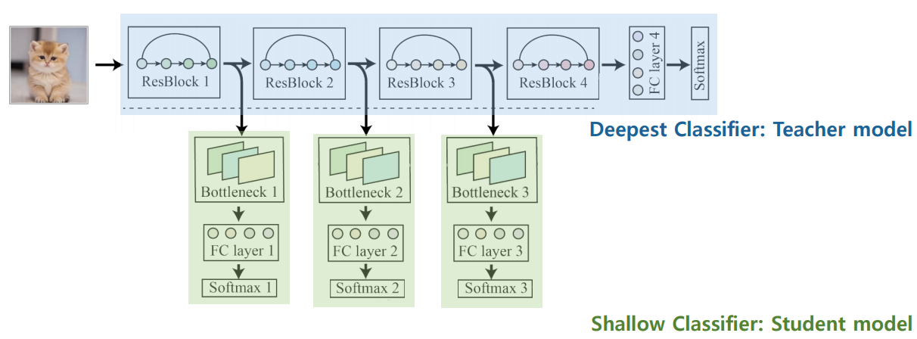
4. Distillation Research
Self Distillation

Slide 19
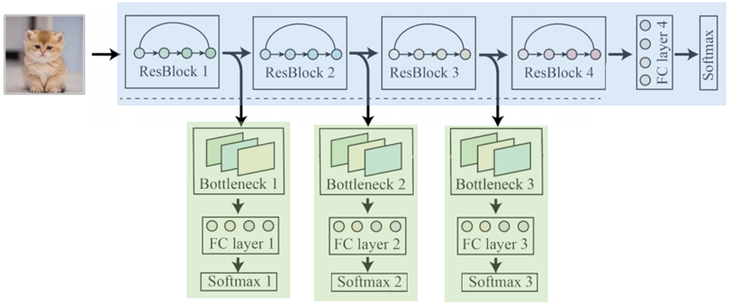
4. Distillation Research
Self Distillation

Slide 20

4. Distillation Research
Self Distillation

Slide 21

4. Distillation Research
Self Distillation

Slide 22
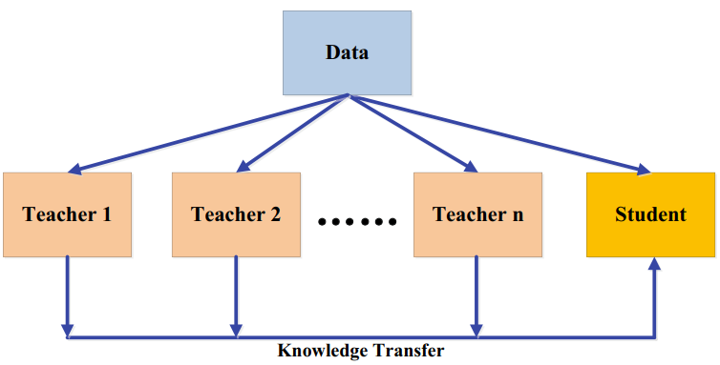
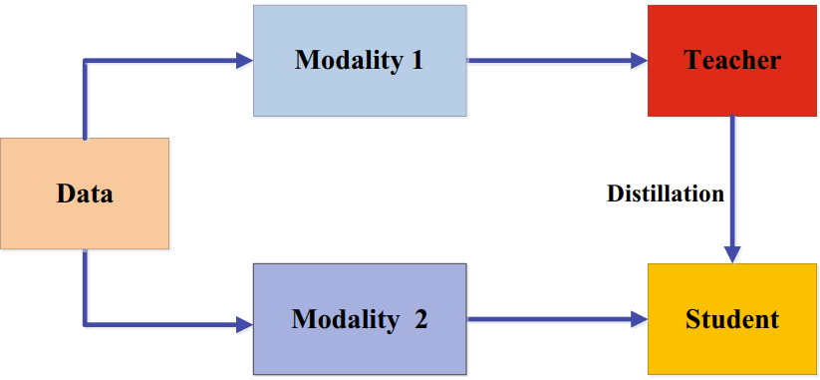
5. Distillation Algorithms
Multi-teacher Distillation
Cross-Modal Distillation

Slide 23
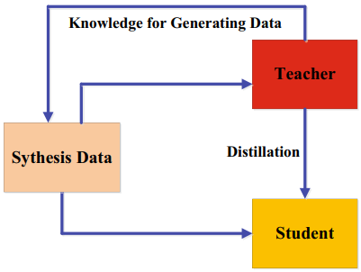
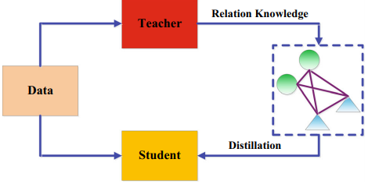
5. Distillation Algorithms
Graph-Based Distillation
Data-Free Distillation

Slide 24
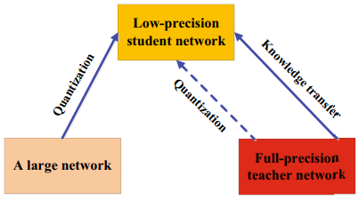
5. Distillation Algorithms
Adversarial Distillation
Attention-Based Distillation
Lifelong Distillation
NAS-Based Distillation
etc...
Quantized Distillation

Slide 25

6. Applications
Visual recognition
Natural language processing
Speech recognition
etc...

Slide 26
References.
황하은. 2020. Intoroduction to knowledge distillation. http://dmqm.korea.ac.kr/activity/seminar/304
EZOBEAR. 2020. Knowle Distillation 리뷰. https://ezobear.github.io/model%20compression/2020/01/02/KD-post.html
Jianping Gou, Baosheng Yu, Stephen J. Maybank, Dacheng Tao. 2021, Knowledge Distillation: A Survey
빛나는나무. 2020. 딥러닝 용어 정리, Kknowledge distillation 설명과 이해. https://light-tree.tistory.com/196

Slide 27
Q & A

